Slide 1
Green University of Bangladesh
Department of Computer Science & Engineering
Subject: Algorithms
Course Code:CSE-205
My Presentation topic :Complexity of Algorithms
Submitted To:
Name :Jargis Ahmed
Designation : Lecturer
Department : CSE
Green University of Bangladesh
Submitted by :
Name : Nazifa Alam Nowrin
ID : 193002101
Section : DC
Green University of Bangladesh

Slide 2

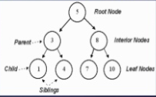
Breadth First Search (BFS)
A Graph G=(V, E) consists a set of vertices, V, and a set of edges, E.
A tree is a collection of entities called nodes. Nodes are connected by edges. Each node contains a value or data, and it may or may not have a child node
Tree is also a Graph.

Slide 3
Outline
DFS of Graphs
Undirected Tree
Directed Tree
Verifying Vertices are Descendants via Preordering of Tree
https://www.slideshare.net/ShuvongkorBarman/presentation-on-breadth-first-search-bfs
https://www.hackerearth.com/practice/algorithms/graphs/breadth-first-search/tutorial/

Slide 4
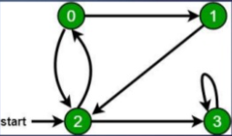
Breadth First Search (BFS)
in the following graph, we start traversal from vertex 2. When we come to vertex 0, we look for all adjacent vertices of it. 2 is also an adjacent vertex of 0. If we don’t mark visited vertices, then 2 will be processed again and it will become a non-terminating process. A Breadth First Traversal of the following graph is 2, 0, 3, 1. 9

Slide 5
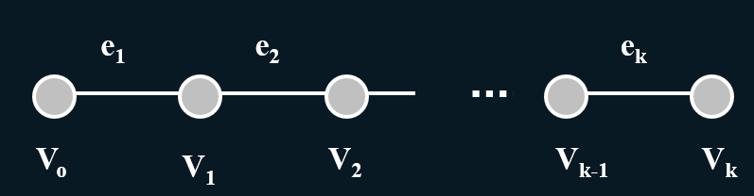
Paths in Graphs
Path p
P is a sequence of vertices v0, v1, …, vk
where for i=1,…k, vi-1 is adjacent to vi
Equivalently, p is a sequence of edges
e1, …, ek where for i = 2,…k each consecutive pair of edges ei-1, ei share a vertex

Slide 6
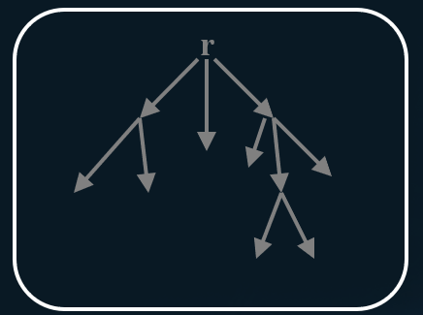
Definition of a Directed Tree
Directed Tree
T is digraph with distinguished vertex root r such that each vertex reachable from r by a unique path
Family Relationships:
- ancestors
- descendants
- parent
- child
- siblings

Slide 7
Half wave rectifier
Suppose we preorder number a Tree T
Let D_{v} = # of descendants of v (found in DFS)
Lemma
u is descendant of v
iff v < u < v + D_{v}
W
*
v
D_{v}
u

Slide 8
Thank you

